Slide 1
Web Reporting
Notes:
Delete this text before publication.
Final Edit Checklist
Delete the dashed red lines from the Master slide.
Save this file in normal slide view. Do not save with any of the Master views open.
Verify that the Help tree navigation paths in the Notes Layout are correct.
Verify that you have deleted any extra blank lines at the end of each of the notes layout pages.
Verify that you have deleted all instructional template text from the notes pages.
Schedule: Timing Topic
<xx> minutes Lecture
<xx> minutes Practice
<xx> minutes Total

Slide 2
Objectives
  After completing this lesson, you should be able to
do the following:
  Identify the attributes of a high quality Web report
  Describe the JavaServer Page run-time environment
  Describe static and dynamic Web reporting
  Add dynamic content to a Web page
  Identify Reports custom JSP tags
  Customize Web reports

Slide 3
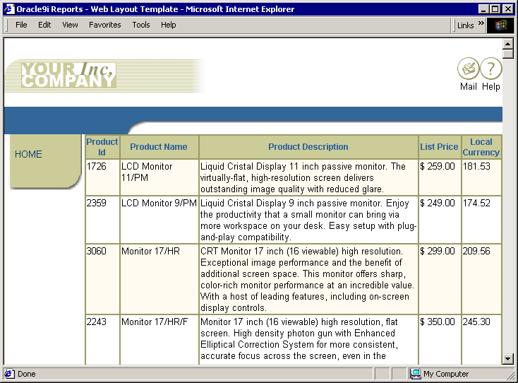

High Quality Web Publishing

Slide 4


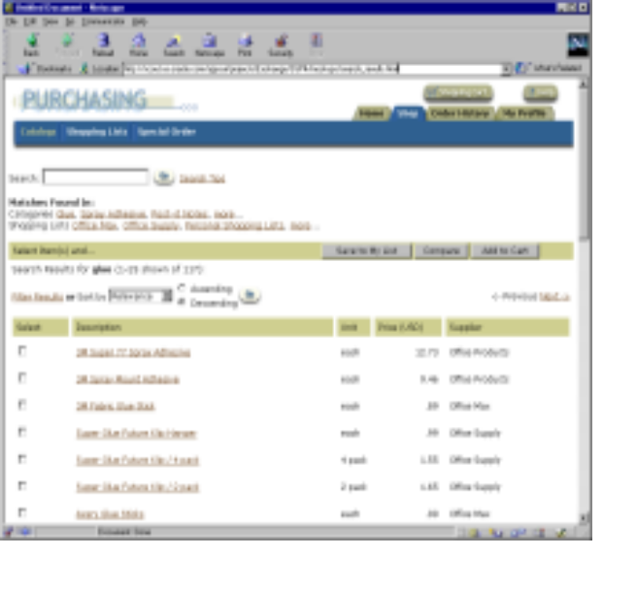
Comparing Static and Dynamic Reporting

Slide 5



Adding Dynamic Content
Report Block Wizard
Graph Wizard
<body>
</body>
Data Model
JavaServer Page (JSP)
Web Source

Slide 6
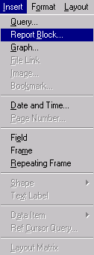
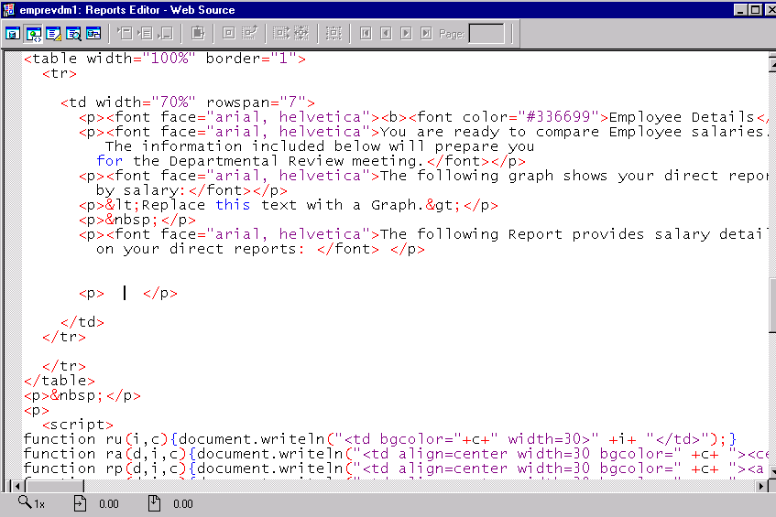
Creating a Report Block

Slide 7
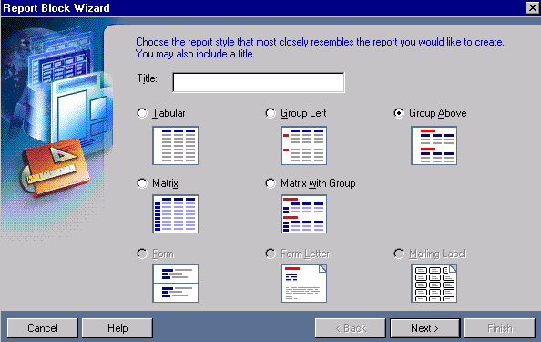
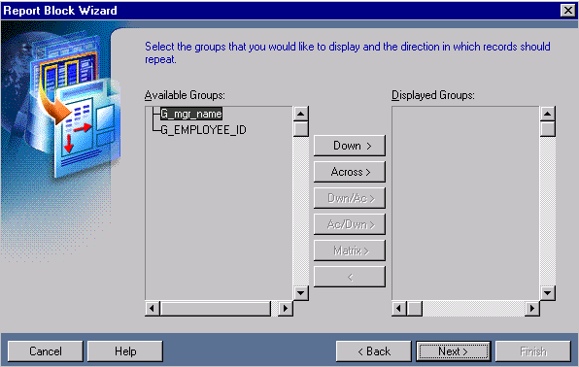
Report Block Wizard

Slide 8
Structure of a Reports JSP
<%@ taglib uri="/WEB-INF/lib/reports_tld.jar" prefix="rw" %>
<%@ page language="java" import="java.io.*" errorPage="rwerror.jsp" %>
<rw:report id="report">
<rw:objects id="objects">
Data Model & Business Logic (XML)
<layout>
Paper Layout (XML)
</layout>
</rw:objects>
<HTML>
Web Layout (JSP)
Graph (XML)
</HTML>
</rw:report>

Slide 9
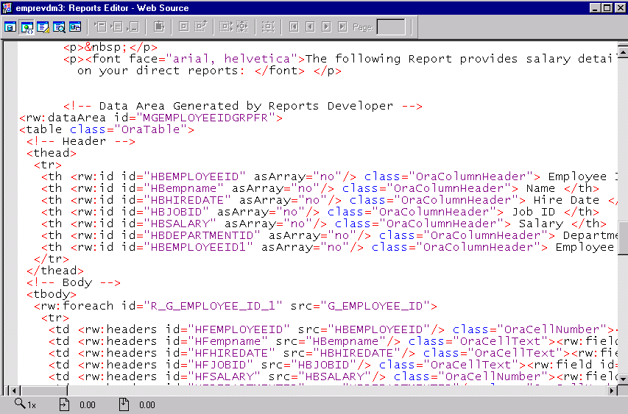
Examining the Web Source Code

Slide 10
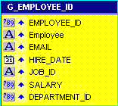
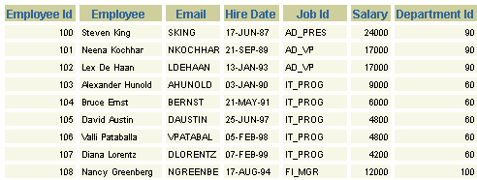
rw:foreach Tag
. . .
<rw:foreach id="R_G_EMPLOYEE_ID_1" src="G_EMPLOYEE_ID">
<tr>
<td <rw:headers id="HFEMPLOYEEID"
src="HBEMPLOYEEID"/>. . .
<td <rw:headers id="HFEmployee"
src="HBEmployee"/> . . .
. . .

Slide 11
rw:field Tag
. . .
<td <rw:headers id="HFEMPLOYEEID" src="HBEMPLOYEEID"/> class="OraCellNumber">
<rw:field id="F_EMPLOYEE_ID" src="EMPLOYEE_ID" nullValue="&nbsp;"> F_EMPLOYEE_ID </rw:field></td>
. . .

Slide 12
Customizing Reports JSPs
  Modify the classes in the style sheet
  Use HTML tags and attributes
  Use Reports custom tags

Slide 13
Customizing Reports JSPs
Using Style Sheets
<rw:style id="rwbeige">
<link rel="StyleSheet" type="text/css" href="rwbeige.css">
</rw:style>
…
<td <rw:headers id="HFEMPLOYEEID"
src="HBEMPLOYEEID"/>
class="OraCellNumber"><rw:field
id="F_EMPLOYEE_ID" src=“EMPLOYEE_ID"
nullValue="&nbsp;"> F_EMPLOYEE_ID </rw:field></td>
.OraCellNumber { color: #000000; background-color: #f7f7e7; font-family: Arial, Helvetica, sans-serif; font-size: 10px ; text-align: right}

Slide 14
Customizing Reports JSPs
Using HTML Tags and Attributes
<thead>
<tr>
<th <rw:id id="HBEMPLOYEEID" asArray="no"/> class="OraColumnHeader"> Employee Id </th>
…
<th <rw:id id="HBSALARY" asArray="no"/> align="right"
bgcolor="yellow"> Salary </th>
</tr>
</thead>

Slide 15
Customizing Reports JSPs
Using Reports Custom Tags
  Tag attributes provide additional formatting
  functionality.
  Example: rw:field tag optional attributes:
  breakLevel
  breakValue
  nullValue
  containsHTML
  formatMask
  formatTrigger

Slide 16
Customizing Reports JSPs
Using Reports Custom Tags
<tbody> <rw:foreach id="R_G_EMPLOYEE_ID_1"
src="G_EMPLOYEE_ID">
<tr>
…
<td
<rw:headers id="HFSALARY" src="HBSALARY"/>
align=“right">
<rw:field id="F_SALARY" src="SALARY"
nullValue="&nbsp;" formatMask="$999,999.00" > F_SALARY
</rw:field>
</td>
…
</tr>
</rw:foreach> </tbody>

Slide 17
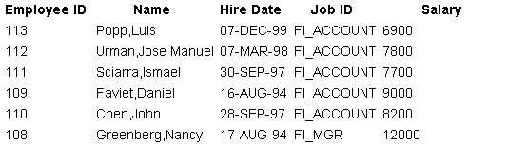
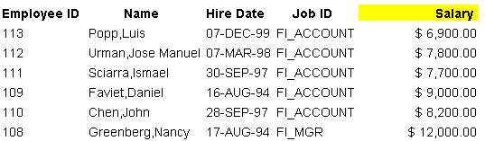
Customizing Reports JSPs

Slide 18
Summary
  In this lesson, you should have learned how to:
  Create a Web report using an existing HTML page and the Report Block Wizard
  Describe the structure of a Reports JSP and identify key custom JSP tags
  Use style sheets to customize Web reports
  Use HTML attributes and Reports custom tag attributes to customize Web reports

Slide 19
Practice 14 Overview
  Adding dynamic content to an existing Web page
  Customizing a Web report using JSP tag attributes

